Slide 1
Rendering Translucent Object with BSSRDF
何家宇
高剑书 赵冬昊

Slide 2
Introduction
It is a simple model for subsurface light transport in translucent materials.
BRDF models cannot capture, such as color bleeding within materials and diffusion of light across shadow boundaries.
The technique can be used to recover the optical properties of a variety of materials, including milk, marble, and skin.

Slide 3
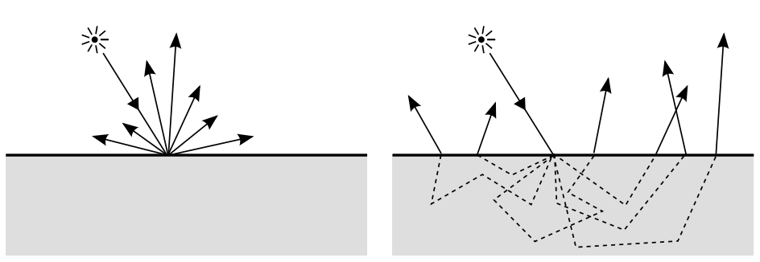
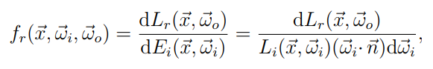
BSSRDF
BRDF

Slide 4
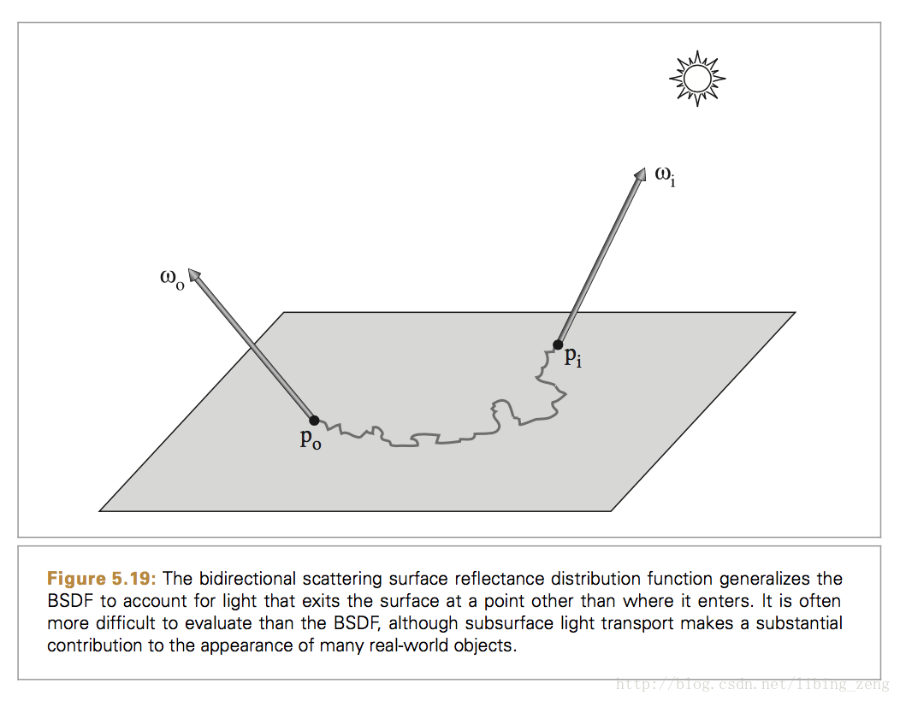
BSSRDF

Slide 5
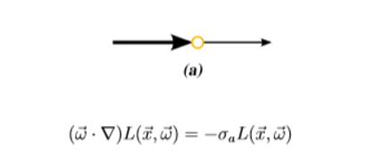
Volumetric Scattering
Absorption

Slide 6
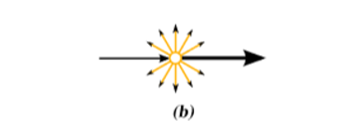
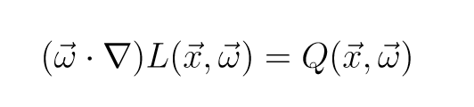
Emission

Slide 7
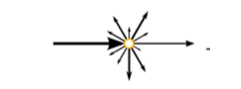
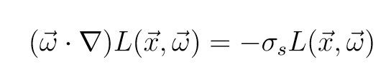
Outscattering

Slide 8
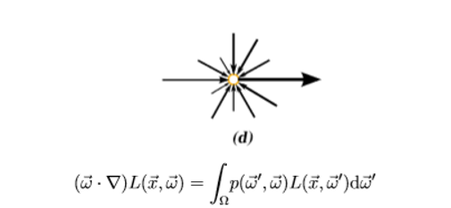
Inscattering

Slide 9
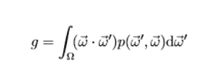
Phase function

Slide 10
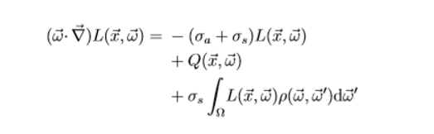
RTE

Slide 11
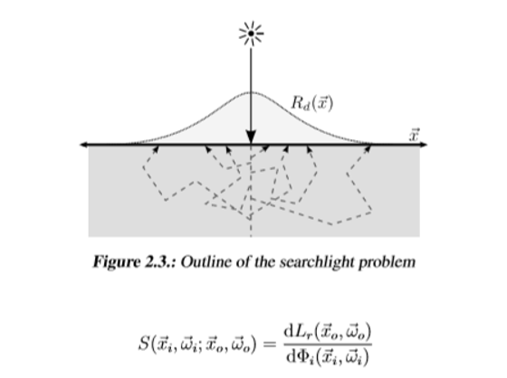

Slide 12
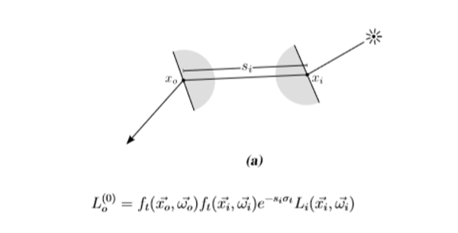
Reduced Radiance

Slide 13
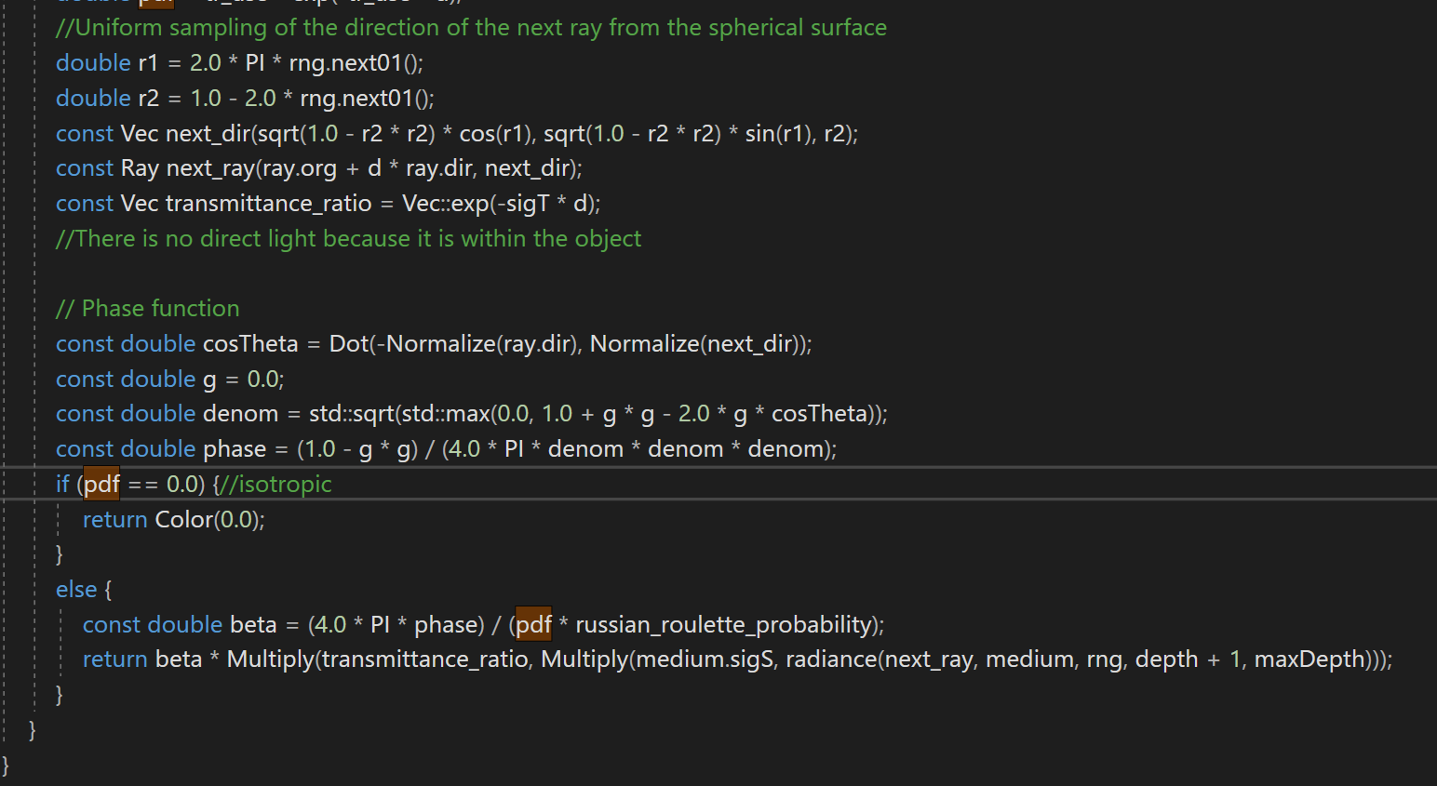
Single scattering

Slide 14
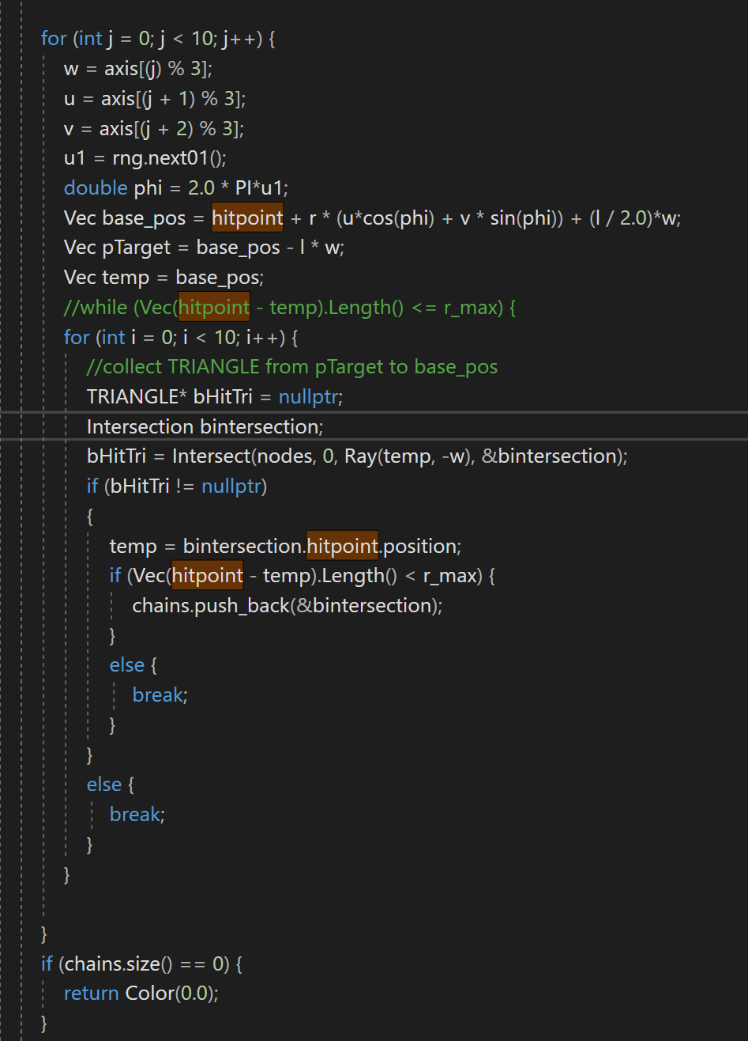
Multiple scattering (check the end point)

Slide 15
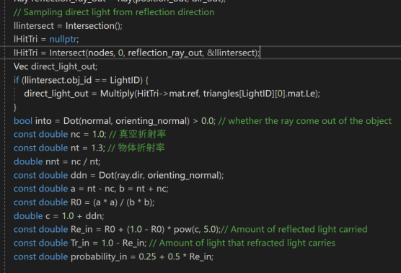
The reflection calculation is based on the reflection law.

Slide 16
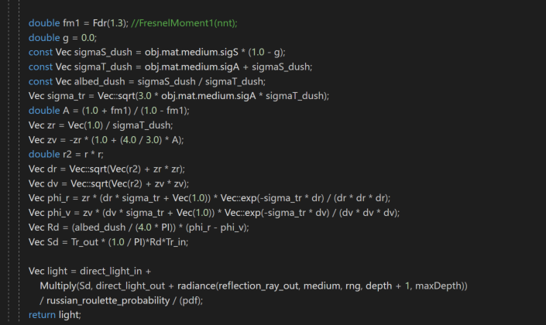
And combined with the refraction ray, we get the surface color (the representation of the “emission”)

Slide 17
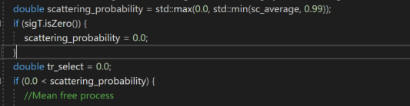
scattering probability:

Slide 18
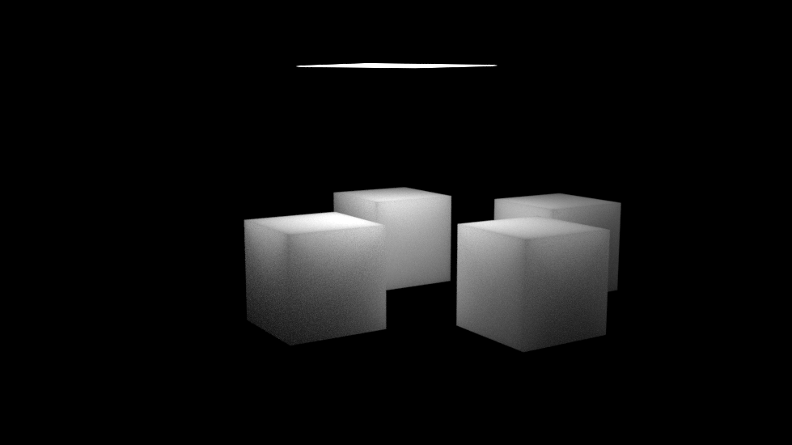
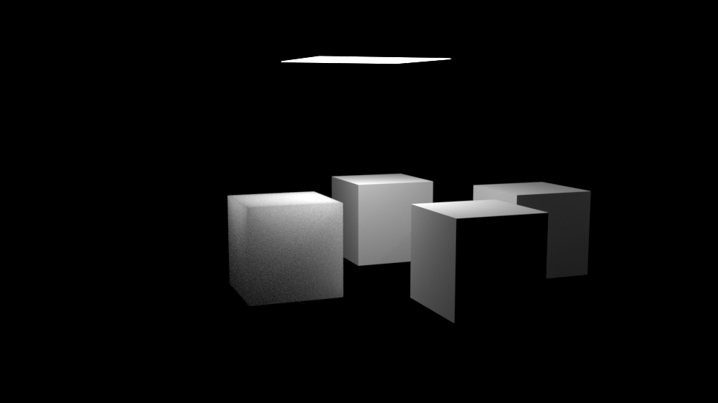

Slide 19
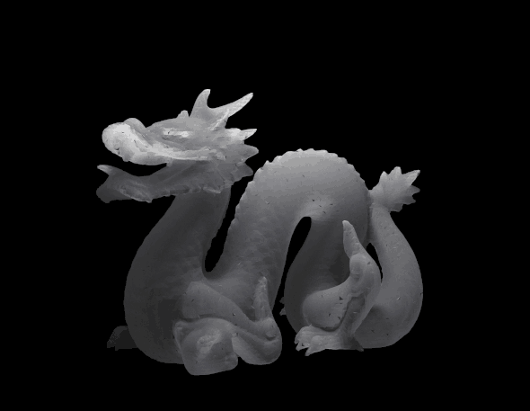
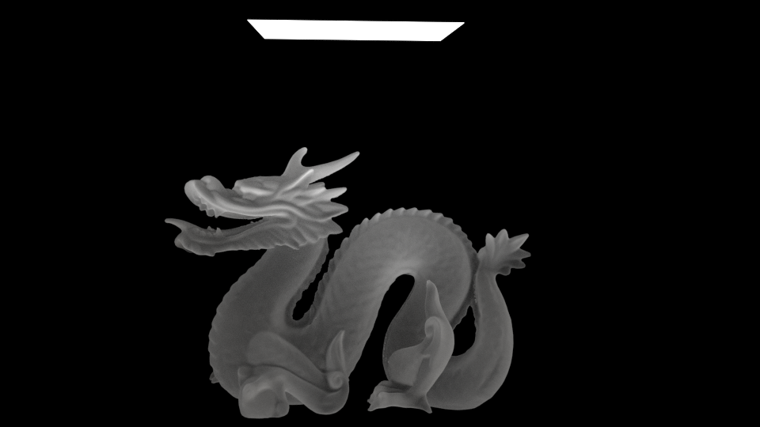
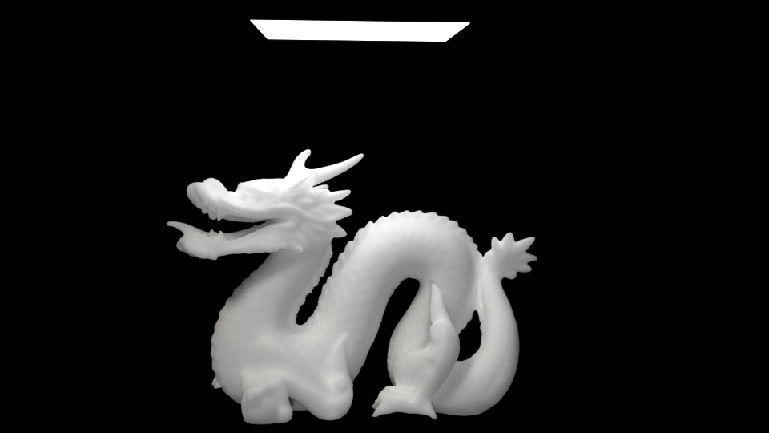

Slide 20
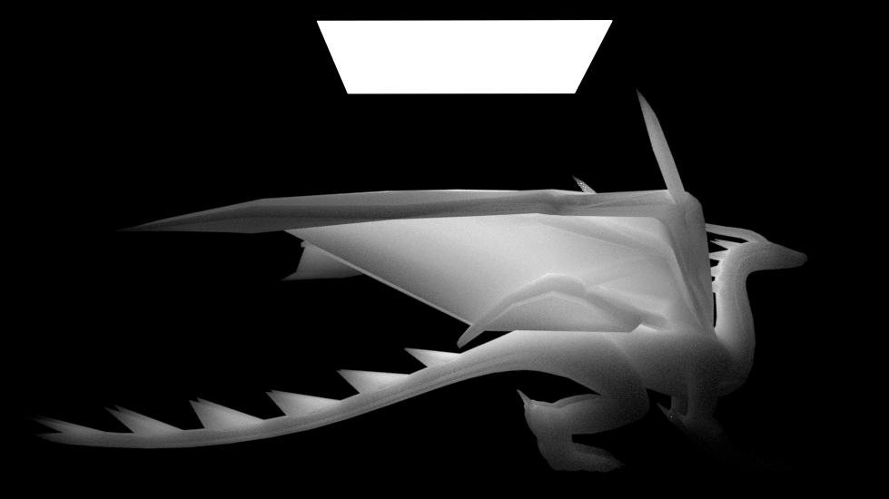
Last result

